Slide 1
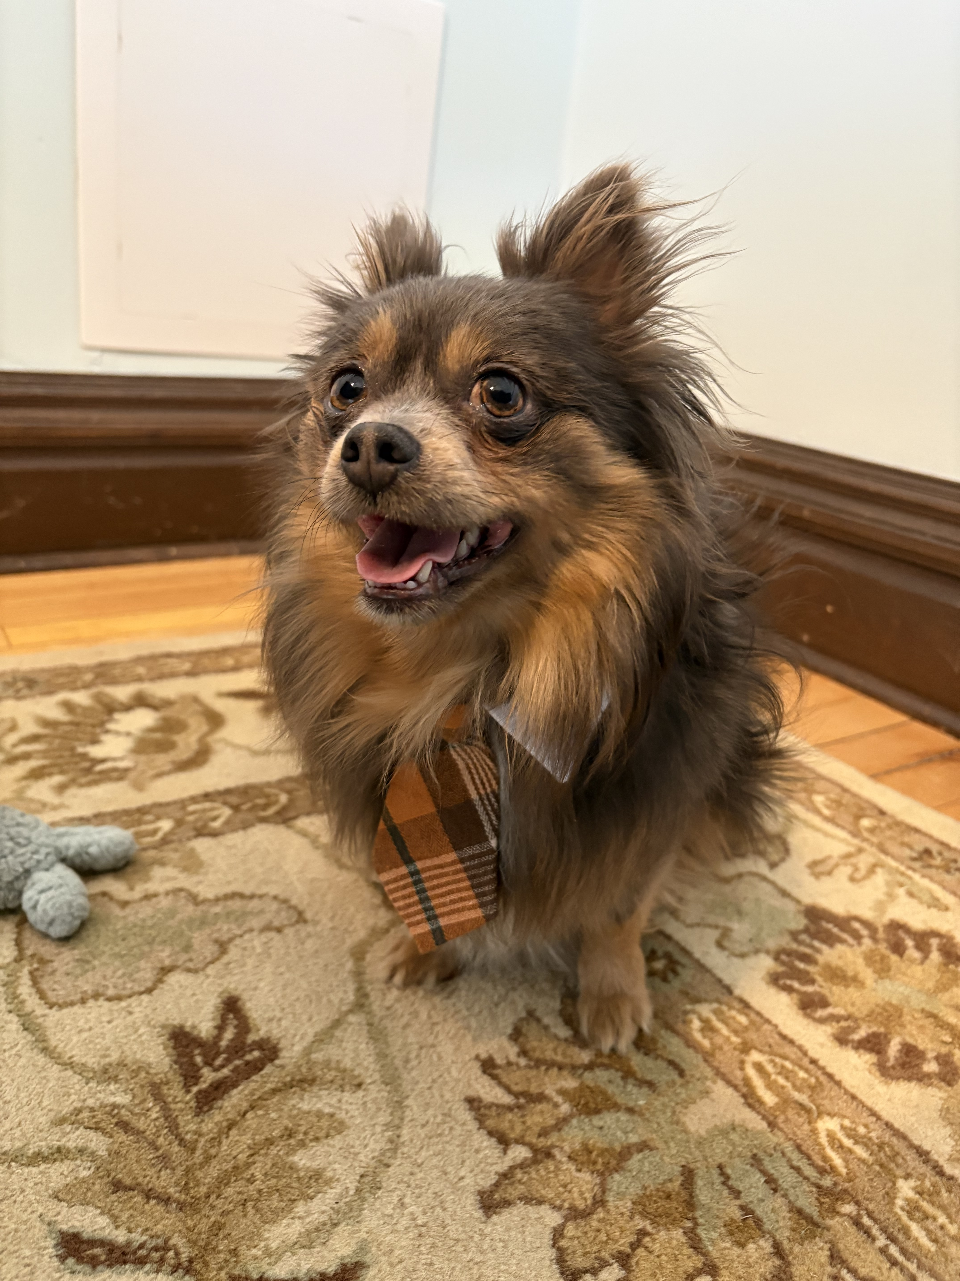
Purr-poseful Planning: Estate Planning for Pet Lovers
Schromen Law, LLC

Slide 2
Pets Are Family Too
Schromen Law 2026 ©

Slide 3



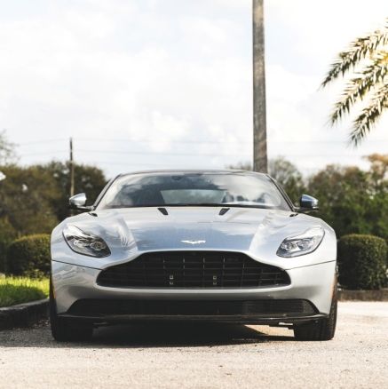
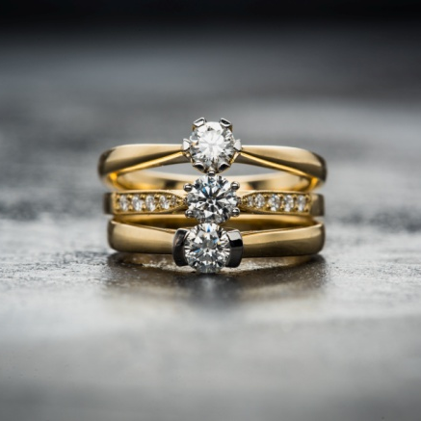

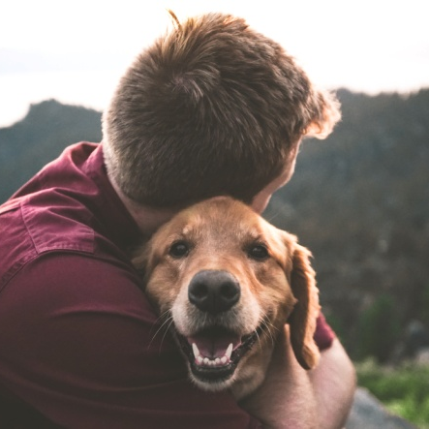

An “estate” is simply all the “stuff” a person owns, including pets!
REAL
ESTATE
STOCK
&
BONDS
BANK
ACCOUNTS
VEHICLES
JEWELRY
RETIREMENT
ACCOUNTS
PETS
INTEREST
IN
ASSESTS
Schromen Law 2026 ©

Slide 4
What happens to your pet without a plan?
Schromen Law 2026 ©
Notes:
-Pets are legally classified as property
-Some rescues may require that an animal adopted through them be given back should that pet’s parent pass away.

Slide 5
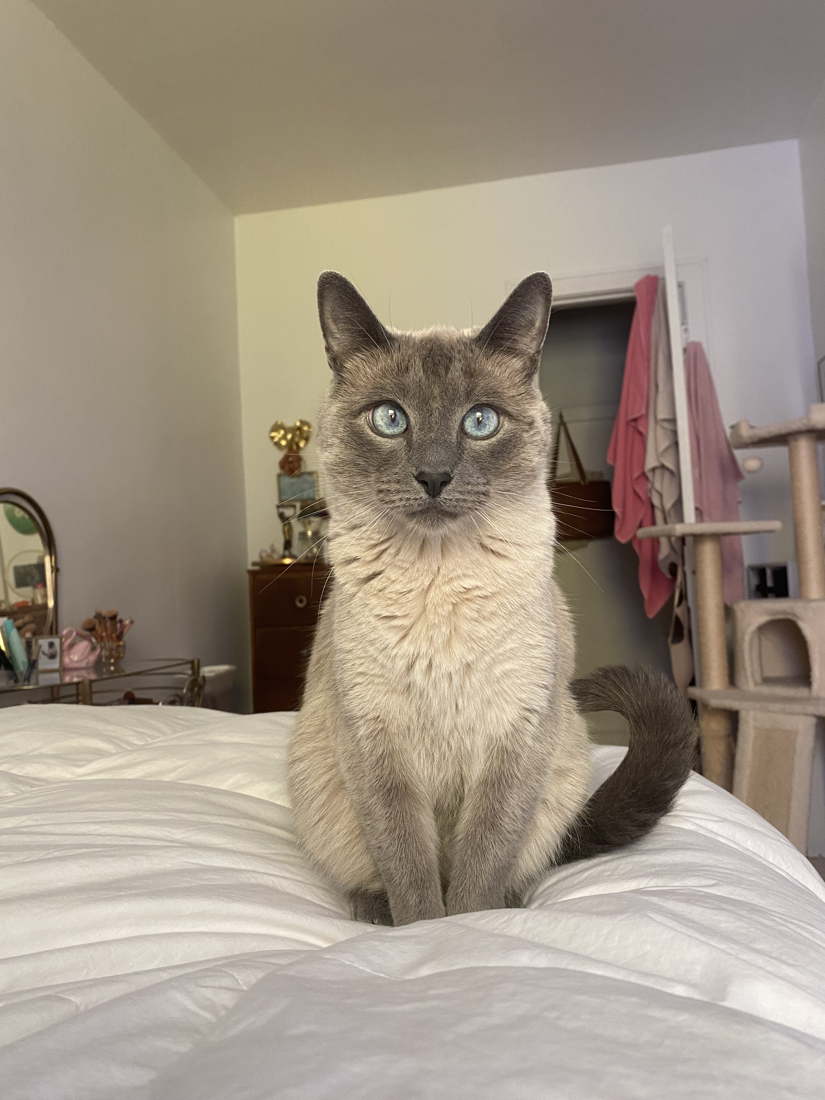
Without A Plan:
Your Pets Future is Left to Chance
Uncertainty in Care, Financial Support, etc.
Create Legally Enforceable Documents
  Will/Trust
Schromen Law 2026 ©

Slide 6
Who Will Care For Your Pet?
Schromen Law 2026 ©

Slide 7
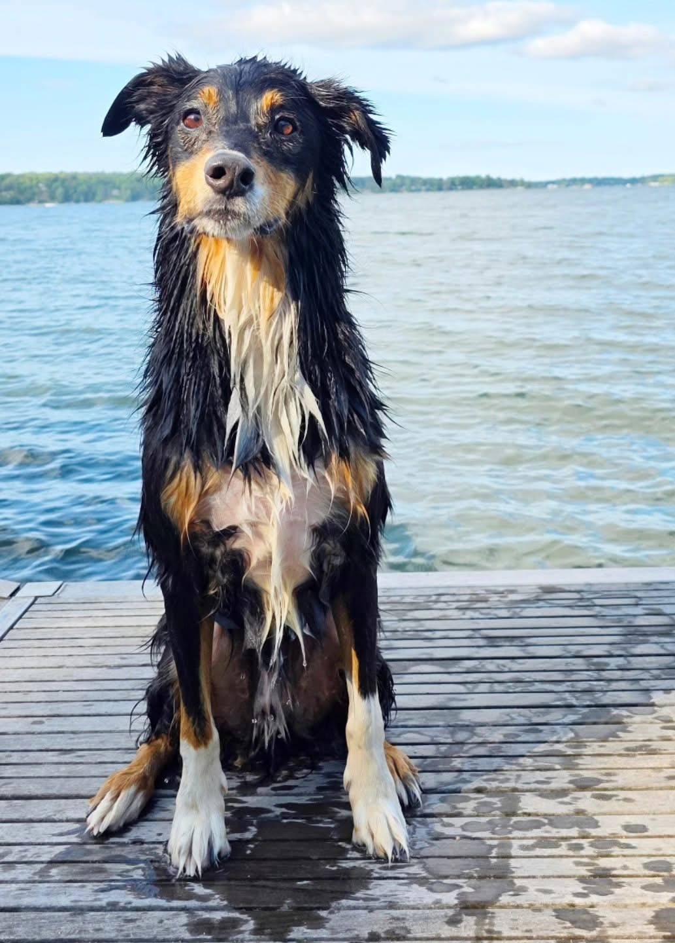
Caregiving & Guardianship
  People, Rescues, Shelters, etc.
Money for Care
  Lump sum, planned for lifetime
Pet Care Instructions
Schromen Law 2025 ©
Schromen Law 2026 ©
Notes:
-Can instruct that your pets remain together

Slide 8
Pet Planning in a Will
Schromen Law 2026 ©

Slide 9
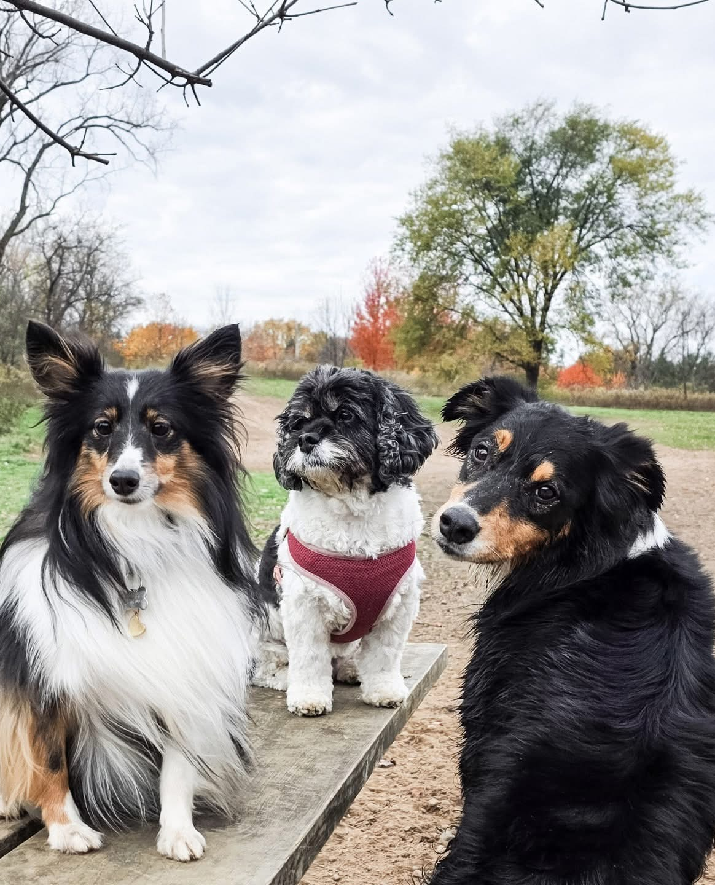
Specific Bequests to Shelters, Rescues, Veterinary Organizations, etc.
Chooses Caregiver
Chooses Back Up Caregiver
Specific Bequest to Caregiver
Schromen Law 2026 ©
Notes:
-Important to note that gifting money to guardian of your pet can come with instructions and wishes, but it cannot be required that the money is spent on the pet

Slide 10
Pet Trusts
Schromen Law 2026 ©

Slide 11
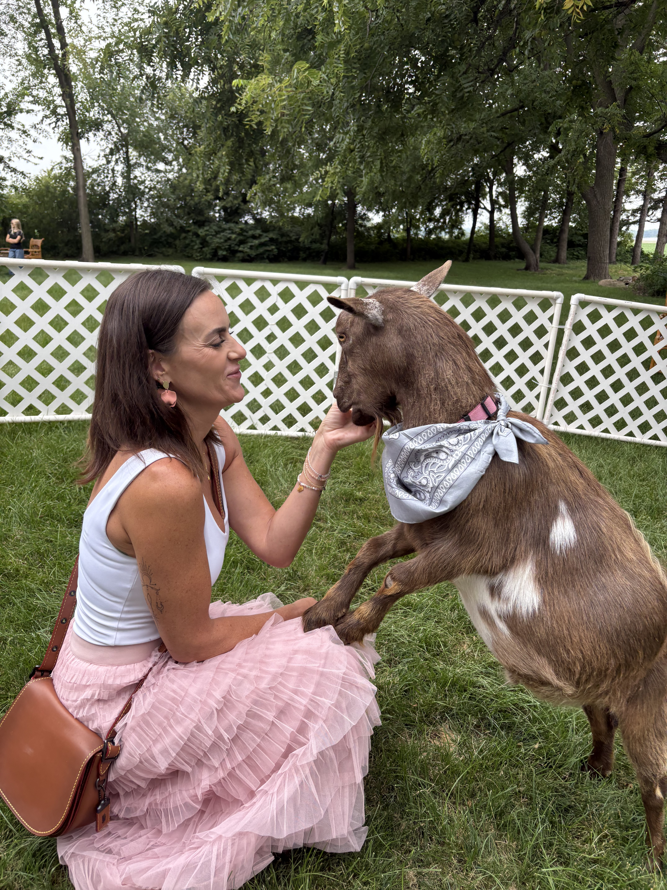
Intentional Planning & Control
Identifies Pet
Appoints a Trustee
Names a Caregiver
Provides Funding
Establishes Instructions
Schromen Law 2026 ©

Slide 12
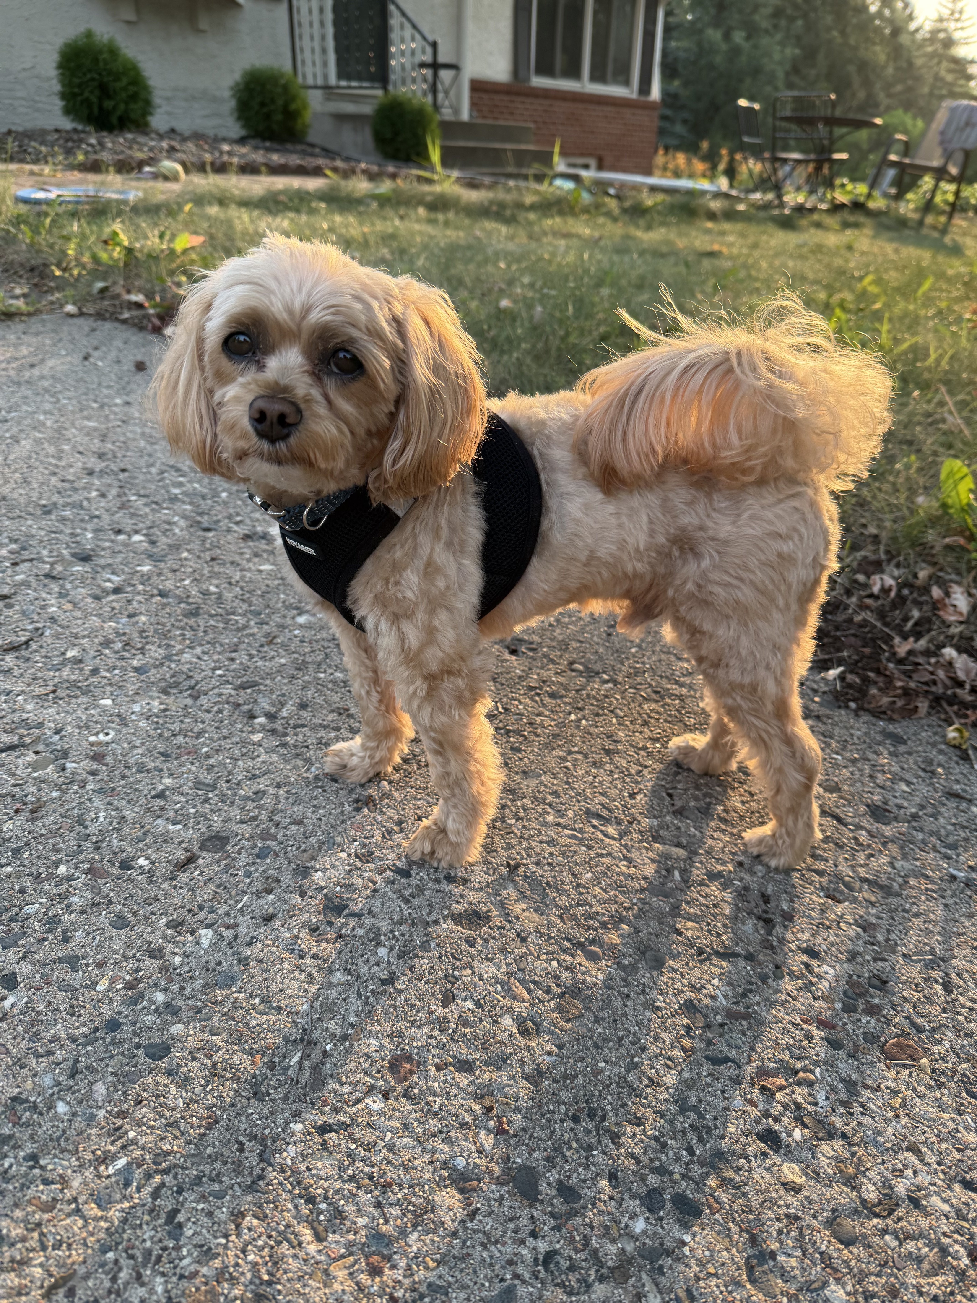
What Amount Should You Leave? Account for ongoing expenses, veterinary care, expected remaining lifetime
What Happens to the Money After Your Pet Passes?
Remainder Beneficiary
Schromen Law 2026 ©

Slide 13
Charitable Planning & Planned Giving
Schromen Law 2026 ©

Slide 14
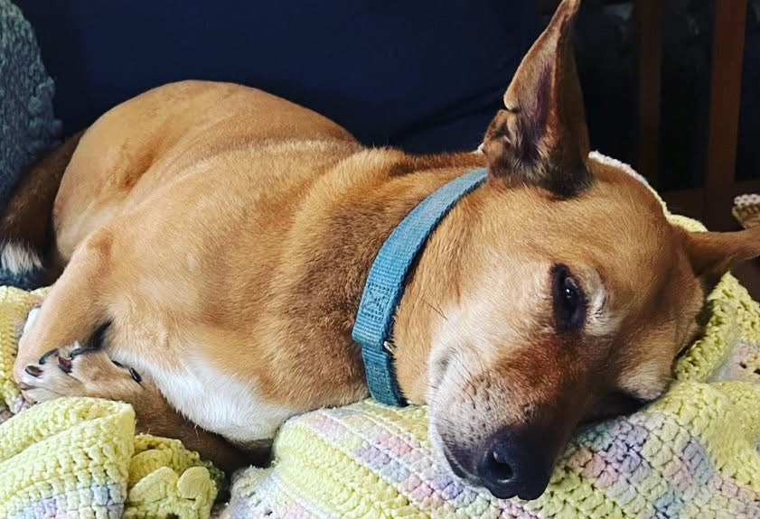
Making Charitable Bequests
  Lifetime Gifts
  Specific Bequests
  Donor Advised Funds
  Charitable Trusts (tax planning)
This type of planning allows you to create and/or leave a lasting legacy
Schromen Law 2026 ©

Slide 15
Beneficiaries
Schromen Law 2026 ©

Slide 16
Beneficiaries
Who
& What
Personal Property
Charitable Giving
Schromen Law 2026 ©

Slide 17
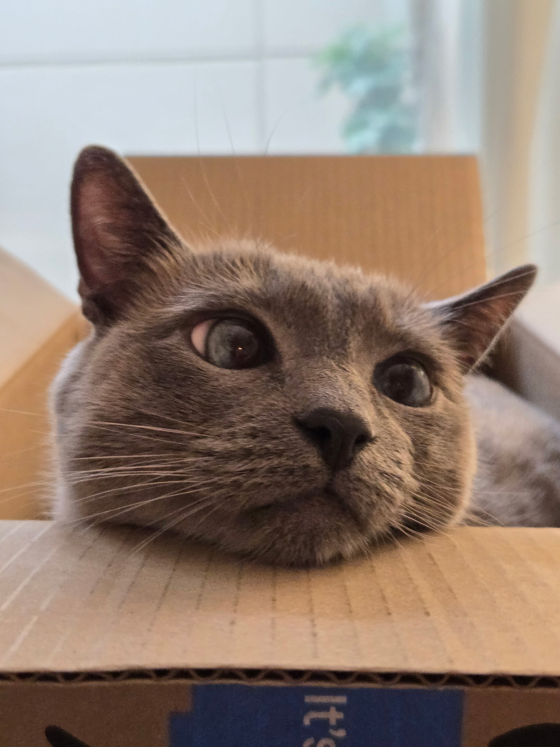
Charitable Giving
Include causes you care about in your planning to create legacy beyond just YOUR pets
Ways to include charities/organizations:
              Leaving Specific Bequest
              Leaving Percentage of Estate
              Leaving a Residuary Gift
              Beneficiary Designations
Schromen Law 2026 ©

Slide 18
Questions?
Schromen Law 2026 ©

Slide 19
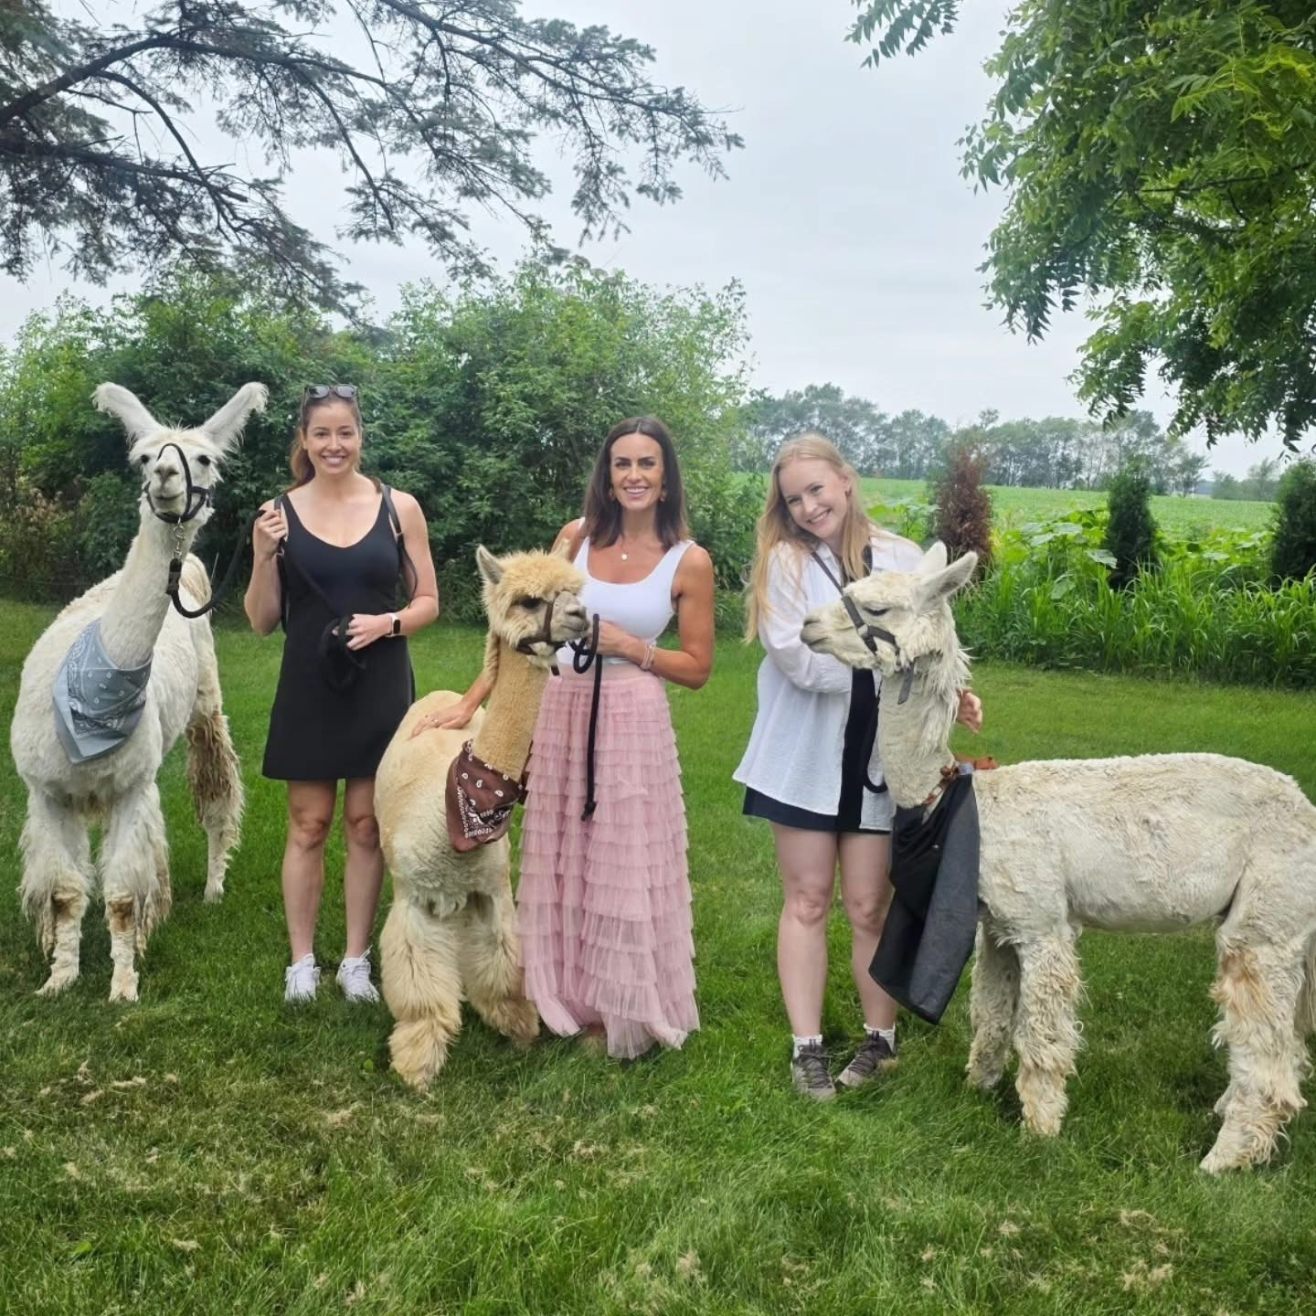
About Us
Schromen Law 2026 ©

Slide 20
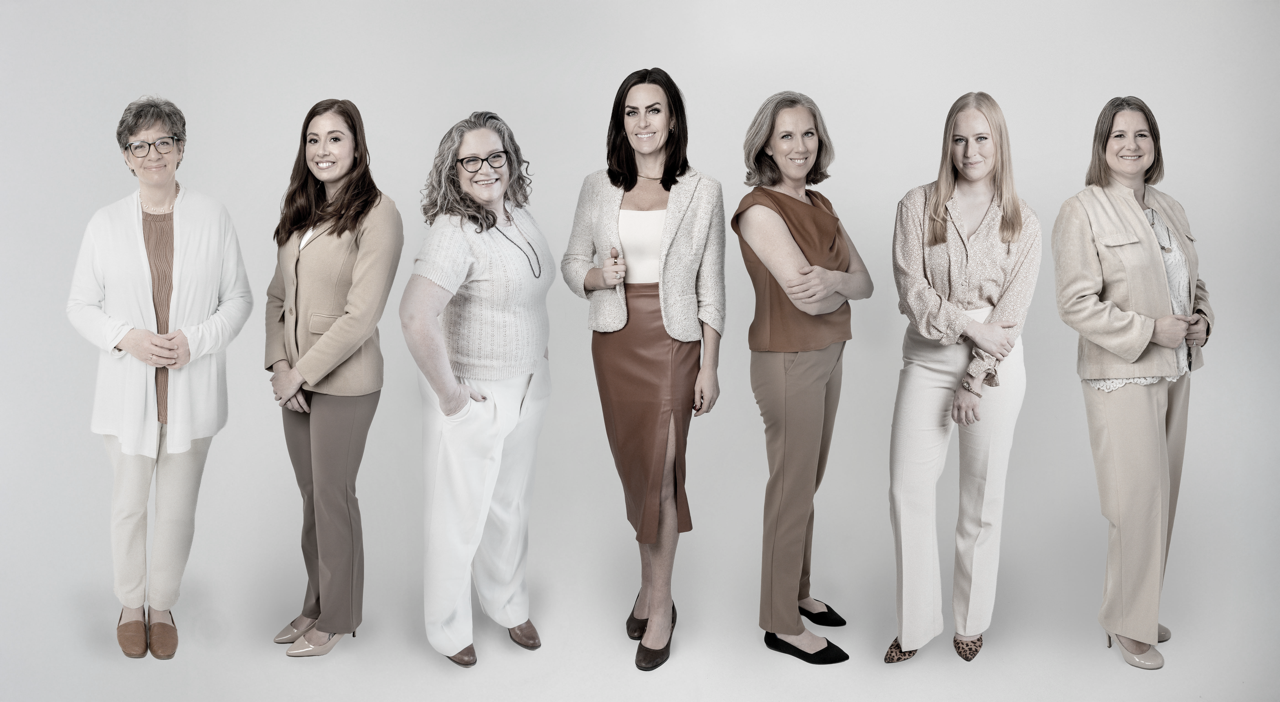
Client Centered
Comprehensive
Supportive
Affordable
Holistic
Schromen Law 2026 ©

Slide 21


Rachel Schromen
Managing Attorney, Owner
651-571-2515
Rachel@SchromenLaw.com
Schromen Law 2026 ©

Slide 22

Vanessa Martin
Senior Attorney
651-571-2515
JennaF@SchromenLaw.com
Schromen Law 2026 ©

Slide 23
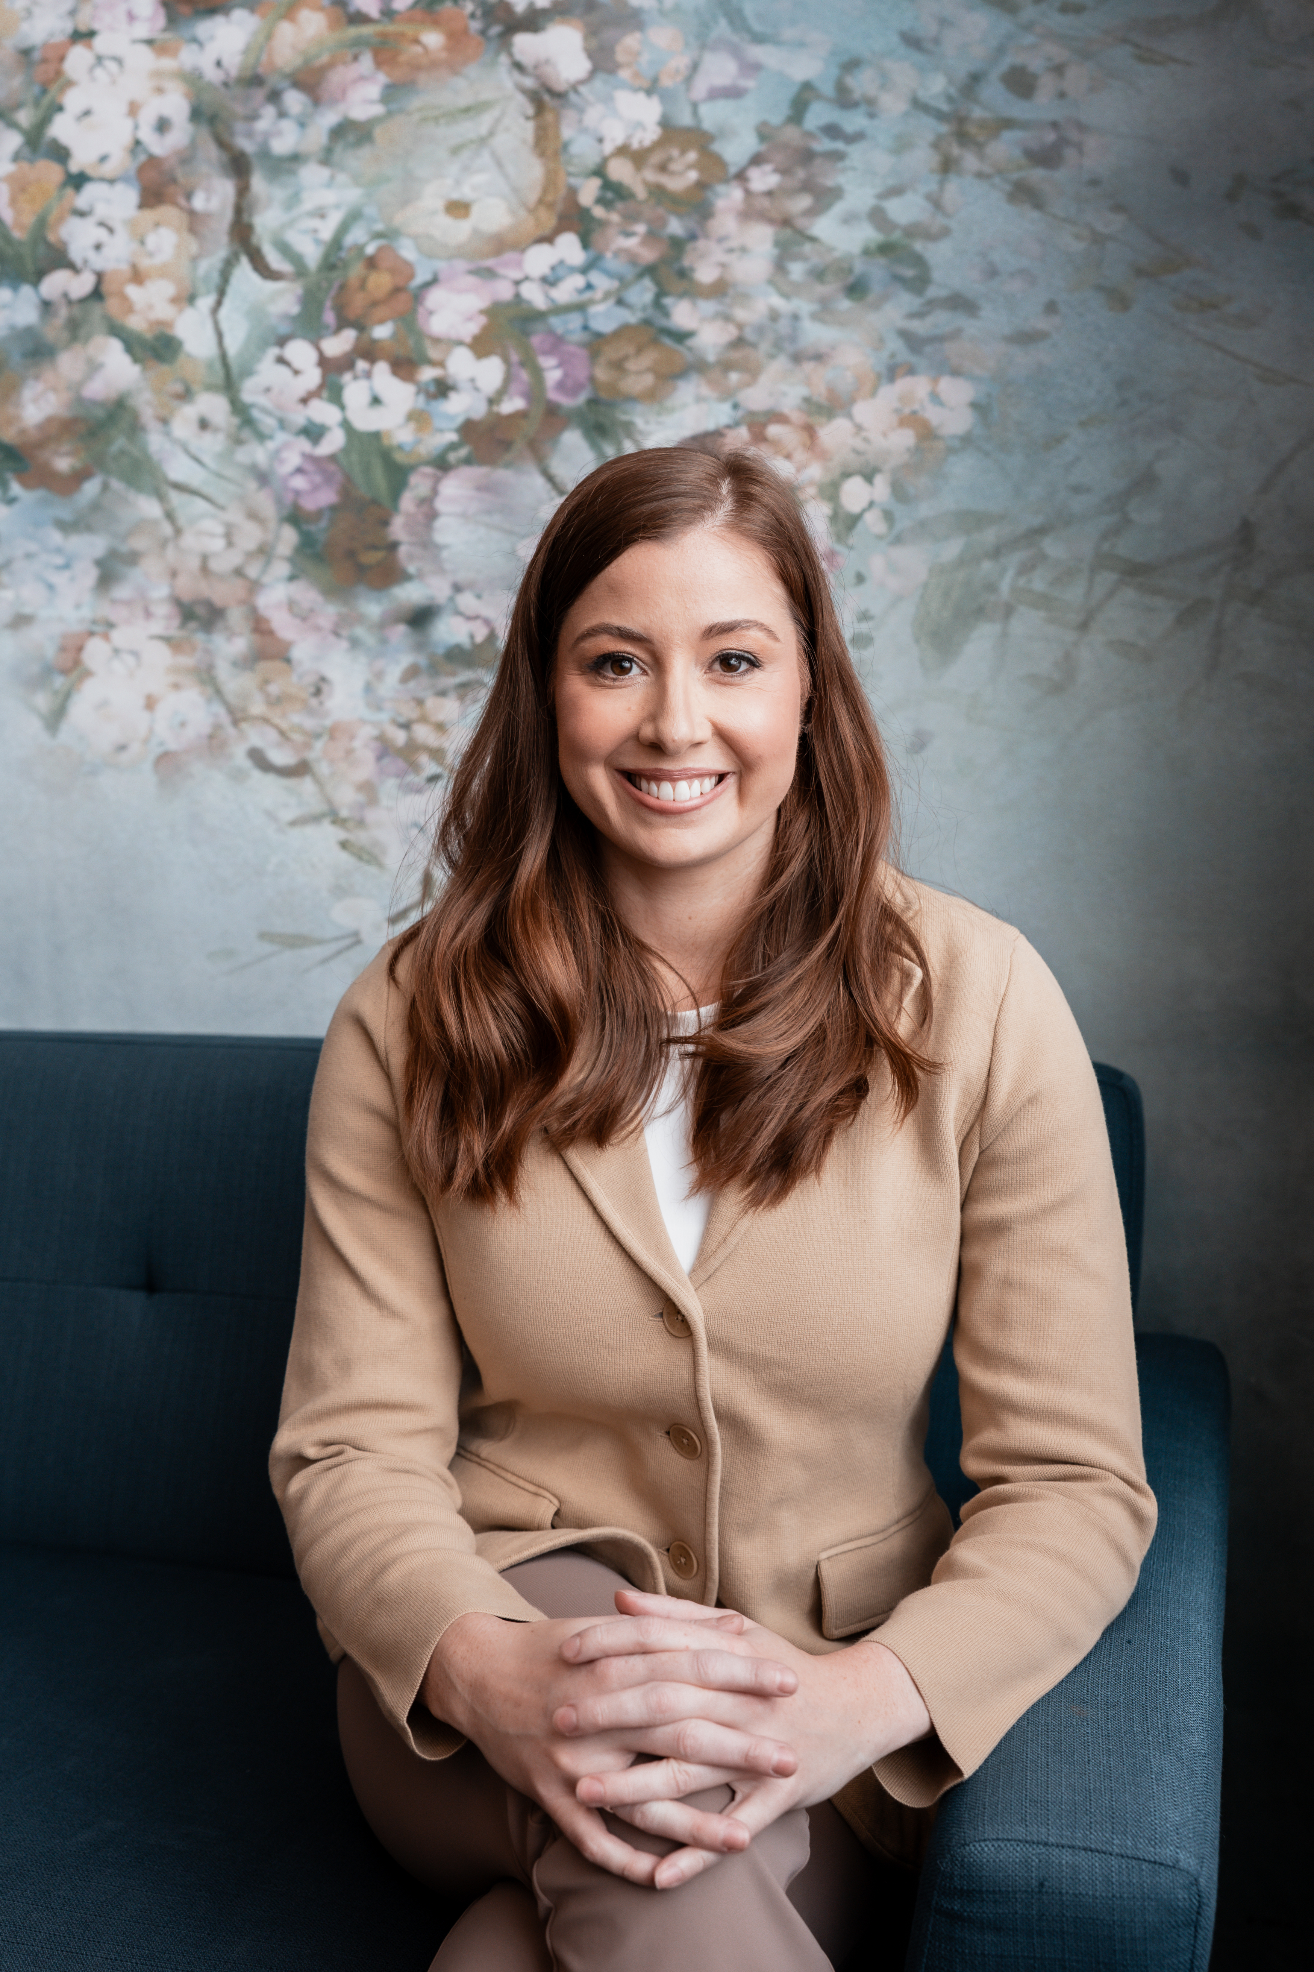
Jenna Firner
Attorney
651-571-2515
JennaF@SchromenLaw.com
Schromen Law 2026 ©

Slide 24
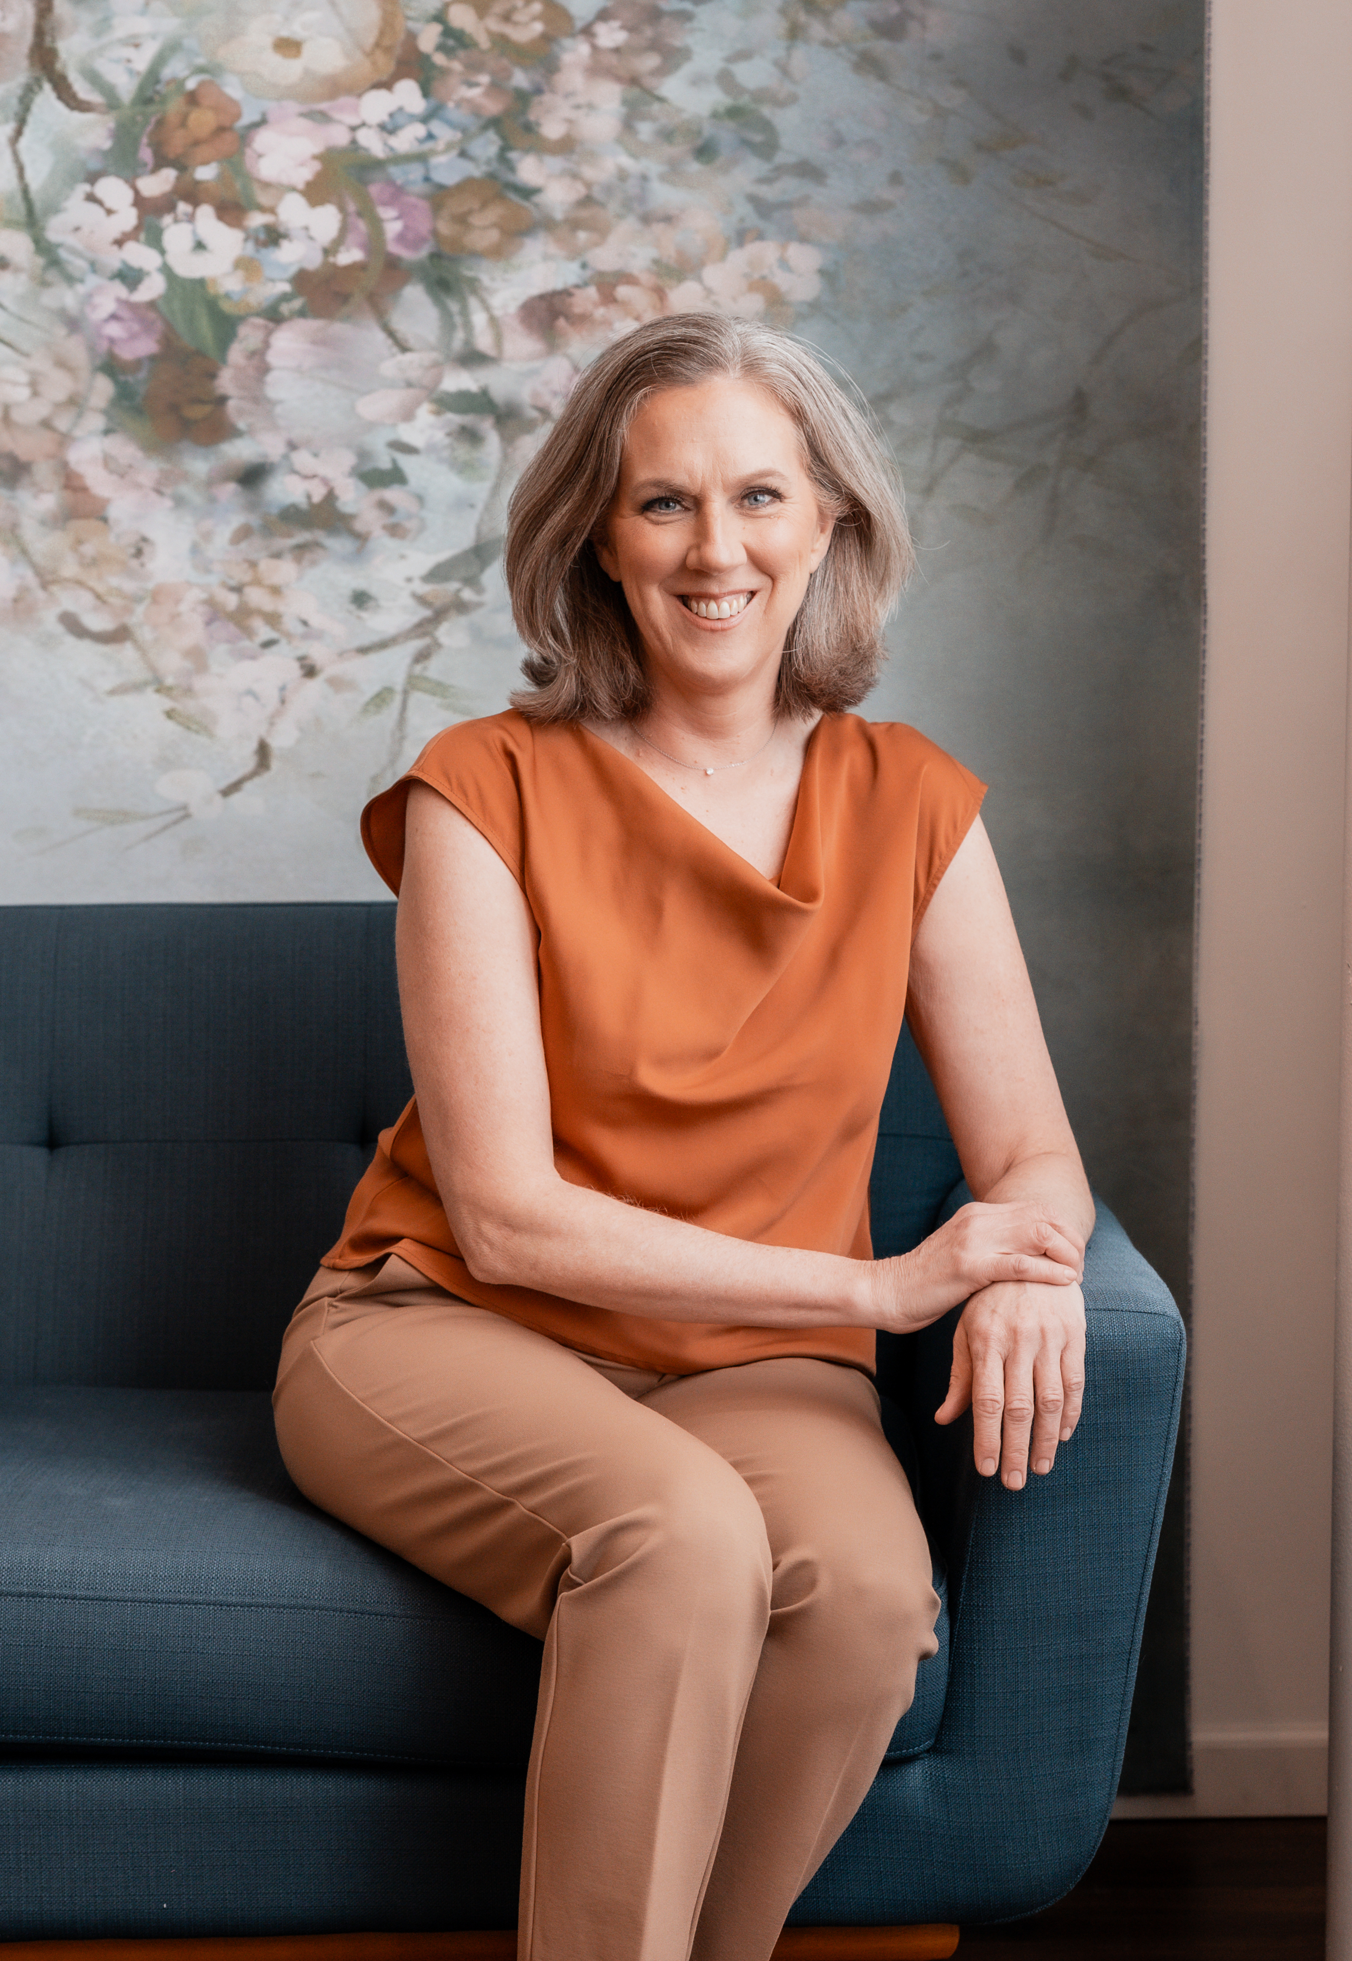
Janet Walsh
Attorney
651-571-2515
Janet@SchromenLaw.com
Schromen Law 2026 ©

Slide 25

Stephanie Nepper
Associate Attorney
651-571-2515
Stephanie@SchromenLaw.com
Schromen Law 2026 ©

